Slide 1
Power System Fault Detection and Classification
CAPSTONE PROJECT
Presented By:
1. Ibrahim Sharif – Dayananda Sagar University - CSE

Slide 2
OUTLINE
Problem Statement
Proposed System/Solution
System Development Approach
Algorithm & Deployment
Result (Output Image)
Conclusion
Future Scope
References

Slide 3
PROBLEM STATEMENT
To design a machine learning model to detect and classify different types of faults in a power distribution system. Using electrical measurement data (e.g., voltage and current phasors), the model must distinguish between normal operating conditions and various fault conditions (such as line-to-ground, line-to-line, or three-phase faults). The objective is to enable rapid and accurate fault identification, which is crucial for maintaining power grid stability and reliability.

Slide 4
PROPOSED SOLUTION
The proposed system aims to detect and classify different types of faults in a power distribution network using machine learning techniques. The solution leverages IBM Watsonx.ai Studio's AutoAI capabilities to automate the model training and optimization process, enabling efficient, accurate, and scalable fault classification.
Components of the proposed solution:
Data Collection:
The dataset was obtained from Kaggle, contains electrical measurement data, specifically voltage and current phasors including environmental conditions like weather and wind speed, fault location, for various systems states including both normal condition and multiple fault types such as Line breakage, overheating and Transformer failure.
These datapoints simulate or reflect real world power system behavior under various fault scenarios.
Data Processing: The dataset was uploaded to IBM Watsonx.ai Studio, where:
Missing values, inconsistencies, and formatting issues were automatically handled.
Feature engineering was applied to generate useful derived metrics that assist in differentiating between fault types.
Machine Learning Approach: IBM Watsonx's AutoAI module was used to automatically:
Select suitable algorithms (e.g., Random Forest, Logistic Regression).
Perform hyperparameter tuning, feature engineering, and pipeline optimization.
Multiple pipelines were generated and ranked based on cross-validation accuracy to identify the most effective model for classification.

Slide 5
PROPOSED SOLUTION
User interface and Deployment: While no separate custom UI or web app was developed, IBM Watsonx.ai Studio provides a highly intuitive and user-friendly interface to:
Upload and explore datasets
Visualize training pipelines
Compare model performances
Export the best pipeline for deployment
Evaluation
AutoAI generated 9 pipelines.
The best-performing model was the Batched Tree Ensemble Classifier (based on Random Forest) with a cross-validation accuracy of 40.9%.
Evaluation metrics such as accuracy and pipeline comparisons were visualized using built-in tools, making analysis easier and transparent.

Slide 6
SYSTEM APPROACH
Data Source: fault_data.csv (uploaded in Watsonx, obtained from Kaggle)
Prediction Target: Fault Type
Preprocessing:
Splitting: Training + Holdout
Handling null values
Feature scaling (AutoAI handles internally)
Pipeline Enhancements:
Hyperparameter tuning (HPO-1, HPO-2)
Feature engineering (FE)
Ensemble creation (Batch)

Slide 7
ALGORITHM & DEPLOYMENT
🔹 Model Selection
IBM Watsonx AutoAI selected the Batched Tree Ensemble Classifier as the best-performing model.
Algorithms explored included Random Forest, Logistic Regression, and their ensemble variants.
🔹 Input Features
Voltage and current phasor readings under different system conditions (Normal, LG, LL, LLL).
Features automatically engineered by AutoAI for better performance.
🔹 Training Process
AutoAI split the dataset into training and holdout sets.
Applied hyperparameter tuning (HPO) and feature engineering (FE) across 9 pipelines.
Cross-validation was used to evaluate each model's accuracy.
🔹 Deployment
The model is ready for deployment directly from IBM Watsonx.ai.
While no separate frontend was created, the IBM Cloud UI itself provides an easy-to-use interface to:
Monitor pipelines
Download/export trained models
Deploy as an API endpoint if needed

Slide 8
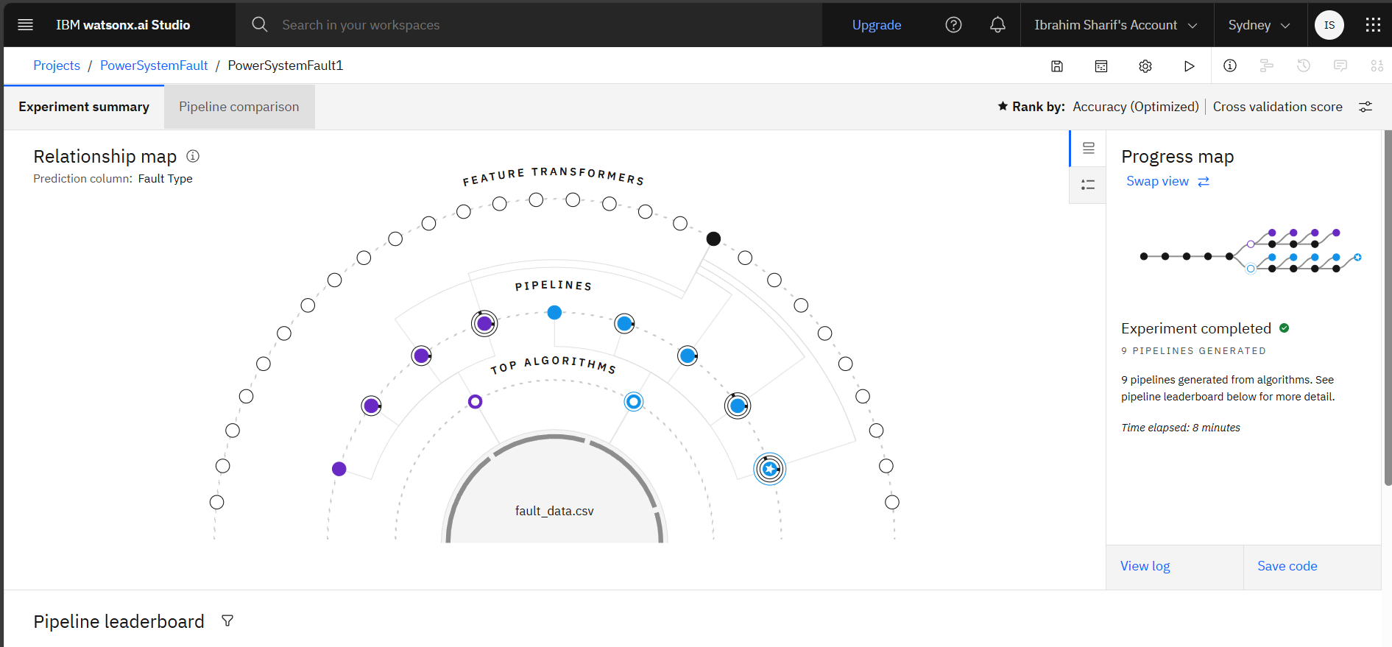
RESULT

Slide 9
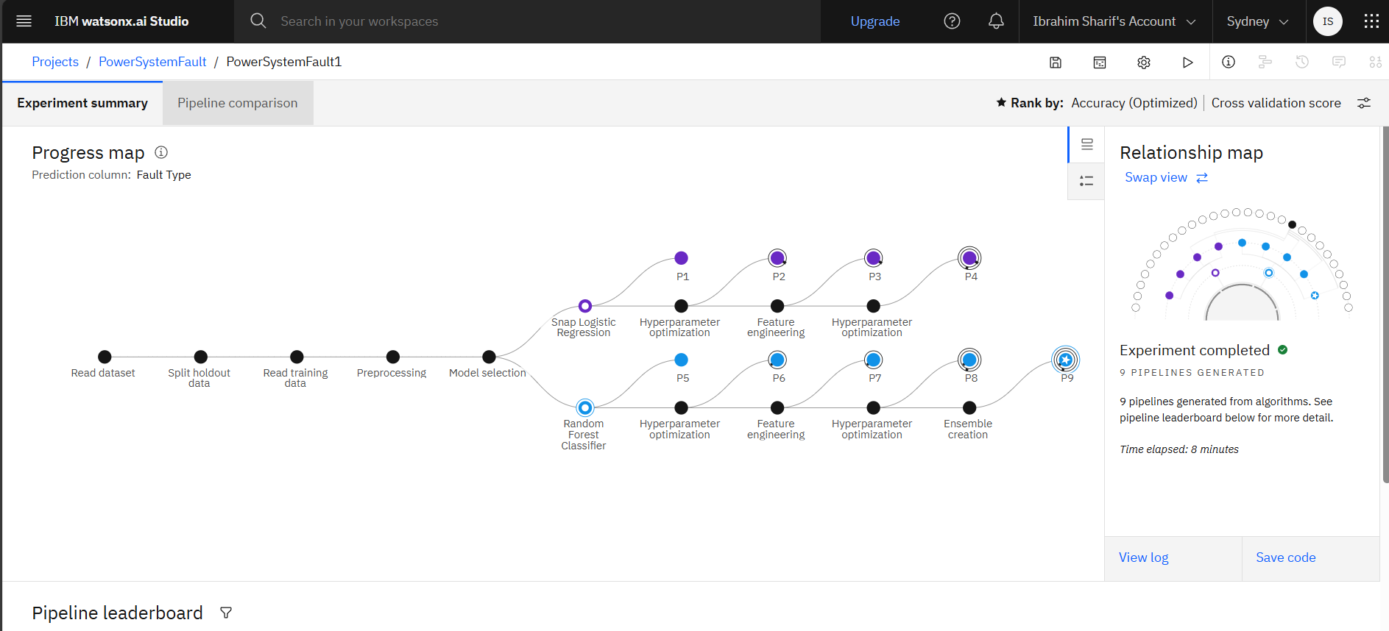
RESULT

Slide 10
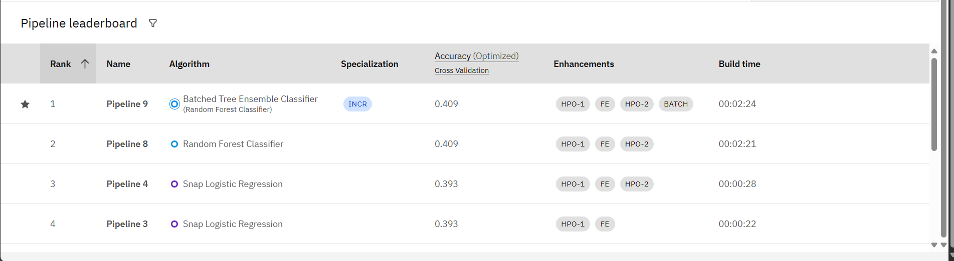
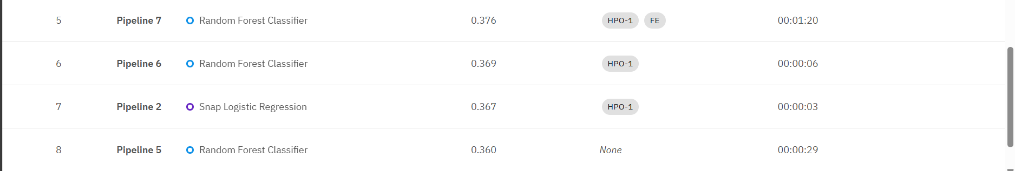
RESULT
The algorithms applied in the pipeline progress:

Slide 11
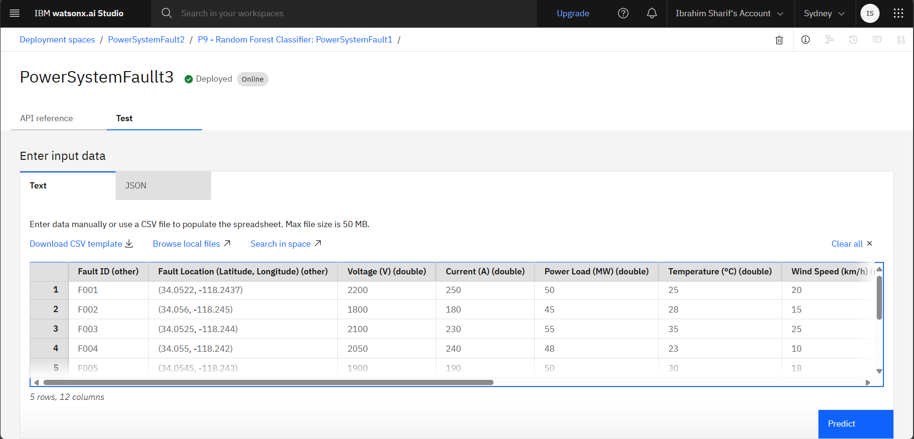
RESULT
Data Input after selecting the most accurate algorithm (Batch tree ensemble classifier):

Slide 12
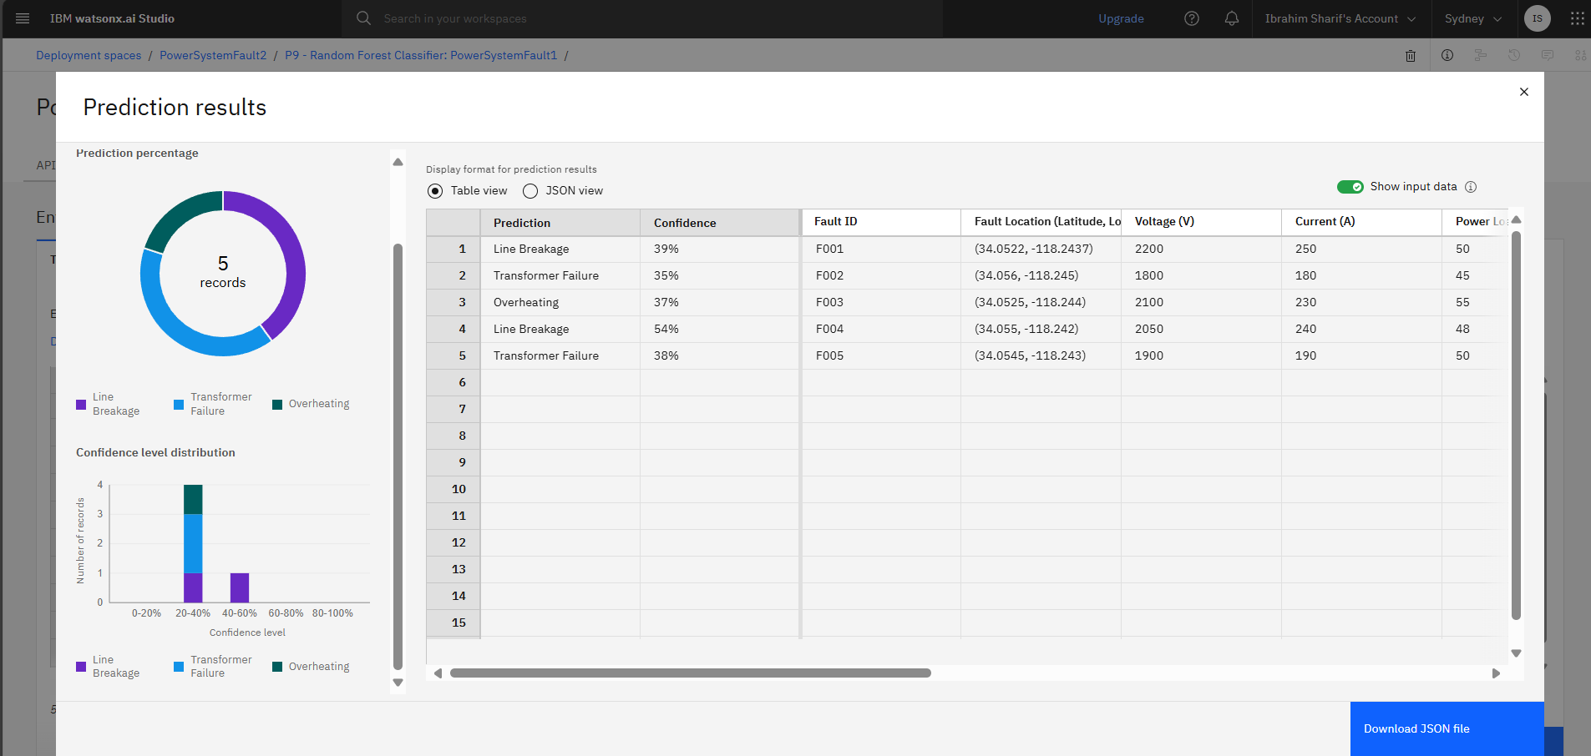
RESULT
Output/Prediction:

Slide 13
CONCLUSION
The project successfully demonstrates the use of machine learning to detect and classify power system faults based on electrical phasor data.
IBM Watsonx.ai AutoAI made the process efficient by:
Automating model training, feature engineering, and tuning
Generating multiple optimized pipelines
Simplifying deployment and evaluation
The best model achieved a cross-validation accuracy of 40.9%, showing the potential for real-time fault detection in power grids.
Although accuracy can be improved with more data and advanced tuning, the current results validate the approach and demonstrate a working proof-of-concept for intelligent fault classification.

Slide 14
FUTURE SCOPE
Data Expansion
Incorporate larger and more diverse datasets, including real-time sensor data from actual grid systems.
Model Improvements
Explore advanced models like LSTM or transformers for time-series fault prediction.
Perform manual feature engineering based on domain knowledge to improve accuracy.
Integration with Grid Systems
Deploy the trained model within SCADA systems for real-time fault monitoring and alerts.
Create a dashboard interface for operators to view and manage fault diagnostics.
Edge Deployment
Adapt the solution for edge computing devices for faster local fault detection in remote substations.
Multiclass Enhancements
Extend the model to classify more fault subtypes and include fault severity levels.

Slide 15
REFERENCES
Fault Detection and Fault Diagnosis in Power System Using AI: A Review - https://www.researchgate.net/publication/381677320_Fault_Detection_and_Fault_Diagnosis_in_Power_System_Using_AI_A_Review
IBM ML - https://www.ibm.com/think/topics/machine-learning
IBM Cloud - https://www.ibm.com/think/cloud

Slide 16
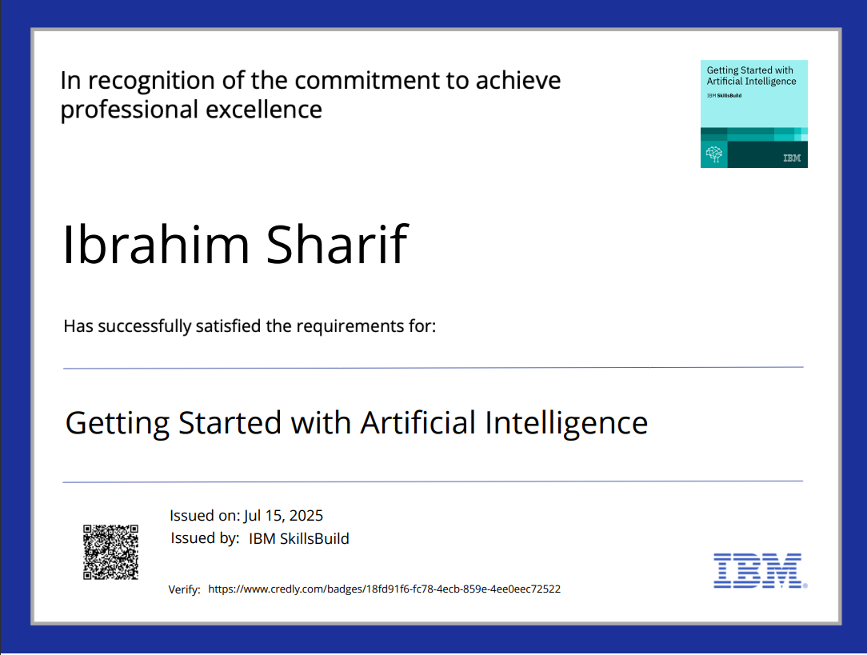
IBM CERTIFICATIONS

Slide 17
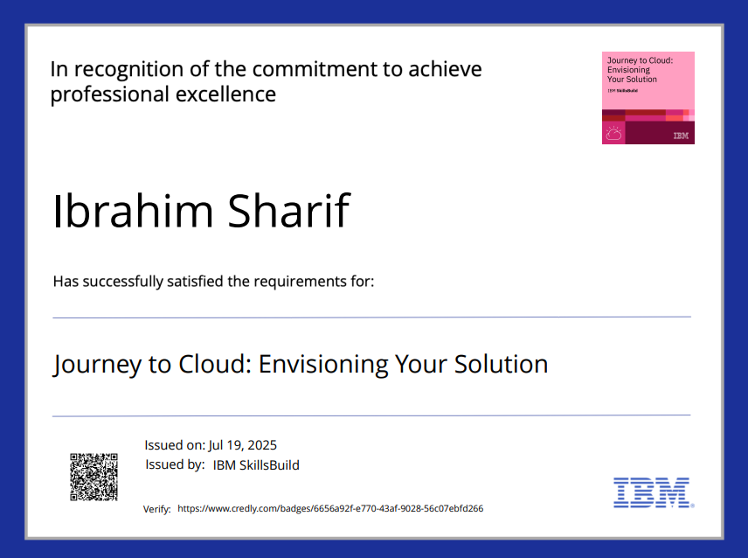
IBM CERTIFICATIONS

Slide 18
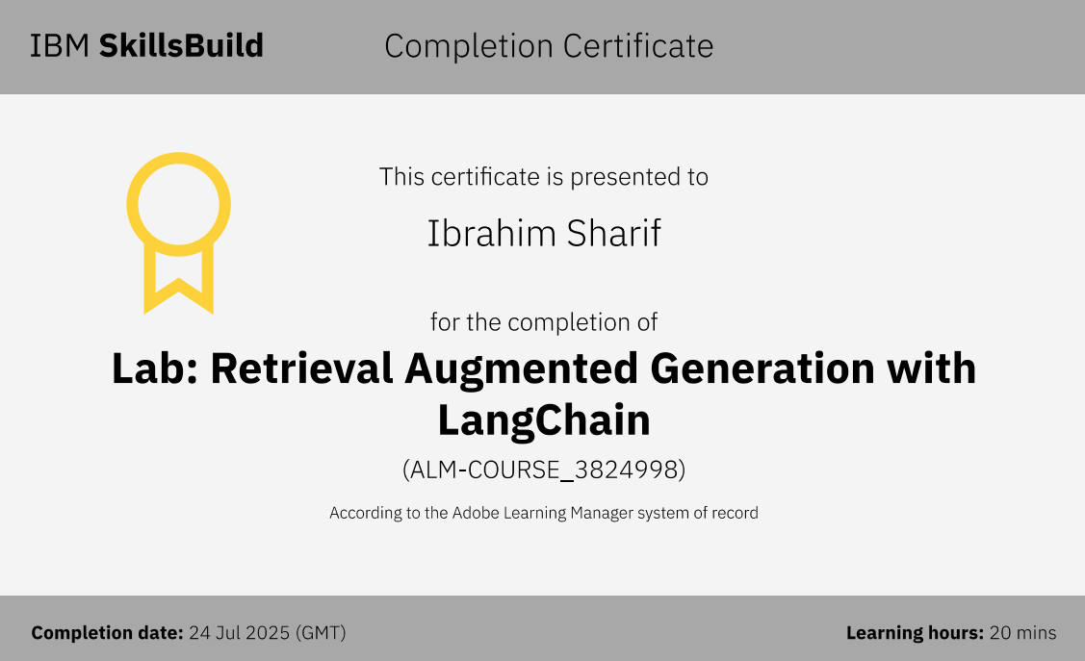
IBM CERTIFICATIONS

Slide 19
THANK YOU

